Slide 1

TOPIC: Inventory & Sales Management System
COURSE NAME: PROBLEM SOLVING WITH PYTHON
COURSE CODE: MCA17101
STUDENT’S NAME: SAYANTAN KUNDU
ROLL NO. = 26102410034
REGISTRATION NO. = 26102000156
STUDENT’S CODE: BWU/MCA/26/038

Slide 2


THE CHALLENGE
The Cost of Manual Tracking
Paper records and basic spreadsheets lead to lost data.
Human Error: Inaccurate stock counts.
Disorganization: Scattered paper receipts.
Time-Consuming: Slow mathematical calculations.

Slide 3



Core Objectives
Replacing slow manual methods with reliable digital automation.
Lightweight Build
Absolute Accuracy
Stock Protection
Fast command-line operation.
Automated math and deductions.
Instant low-stock alerts.

Slide 4




Technology Stack
Python
Pandas
Core application logic.
Data frame manipulation.
Matplotlib
CSV Storage
Visual data reporting.
Permanent local data retention.

Slide 5



SYSTEM ARCHITECTURE
Object-Oriented Design
Product Class
Sale Class
Inventory Class
Individual item attributes.
Transaction logic and math.
Central system hub.

Slide 6


CORE FEATURE
Product Management
Seamless Onboarding
Register completely new items quickly.
Instant Restocking
Update stock levels without re-typing details.
Flexible Sorting
Organize view by price, quantity, or sales volume.

Slide 7
Automated Sales Processing
1
Validation
System checks if sufficient inventory exists.
2
Calculation
Automatically multiplies price by requested quantity.
3
Execution
Deducts stock and generates 7-digit transaction ID.

Slide 8
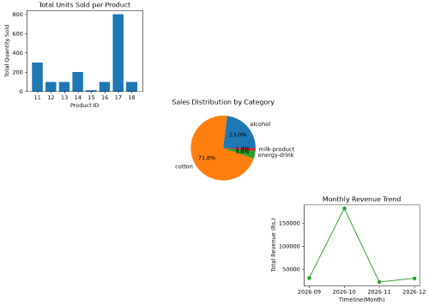
DATA ANALYSIS
Transforming raw CSV data into visual business insights.
Matplotlib Integration

Slide 9
Robust Error Handling
User Mistakes
System Defenses
Requesting 50 units when only 10 are in stock.
InsufficientStockError
Adding a product with an existing ID.
InvalidProductIdError
Entering negative values for stock updates.
ValueError Block

Slide 10
EXPERIMENTAL RESULTS
Performance Validation
100%
0
Pass
Data Retention via CSV
Negative Stock Incidents
Visual Report Generation

Slide 11


Future Enhancements
Hardware Integration
Graphical Interface
Connecting physical barcode scanners for faster checkouts.
Expanding from CLI to a full desktop GUI.

Slide 12
Conclusion
The Inventory and Sales Management System successfully delivers a fast, lightweight, and cost-effective CLI solution tailored for small business operations. By automating tedious manual tasks like updating stock levels and calculating daily revenue, the system significantly reduces human error. It ensures secure data management through seamless CSV file integration, guaranteeing that no critical business records are lost between sessions. Furthermore, it goes beyond basic record-keeping by transforming raw sales numbers into actionable visual insights using automated charts. Ultimately, this project provides a highly organized, scalable foundation that requires no expensive hardware, leaving clear potential for future enhancements like barcode scanning or a graphical interface.
Thank You

